Slide 1
Local Control and Accountability Plan Committee
Meeting
5.29.18
Notes:
Good evening!

Slide 2
Objectives for Tonight’s Meeting
Review Highlights from Stakeholder Input and California Healthy Kids Survey
Review 8 State Priorities and the Required Data Elements
Review Accountability changes, including Graduation Rate Calculation
LCAP for 2018-19: Questions and Comments

Slide 3
Stakeholder Input
LCAP Annual Input Survey
District English Learner Advisory Committee
LCAP Committee
Site Administrators
California Healthy Kids Survey
California School Staff Survey
California School Parent Survey (in progress)
Notes:
These are the questions that we ask ourselves in this process of reflection and analysis

Slide 4
Input from Surveys
Priorities
Improving Teaching and Learning
Facilities Maintenance, Repair, and Upgrade
Professional Learning
Interventions and Targeted Academic Support
Textbooks and Materials
Behavioral Support
Special Education
Outreach and Support for Parents and Families
Notes:
Priorities from the narrative comments in our Annual Survey

Slide 5
California Healthy Kids Survey
From 2017 to 2018, student sense of safety and sense of school connectedness has declined, for every grade level surveyed. *5th grade results are pending
 | Student Sense of Safety |  | Student Sense of Connectedness
 | 2017 | 2018 | 2017 | 2018
7th grade | 65% | 53% ↓ | 58% | 49% ↓
9th grade | 51% | 50% ↓ | 36% | 37% ↑
11th grade | 63% | 53% ↓ | 44% | 40% ↓

Slide 6
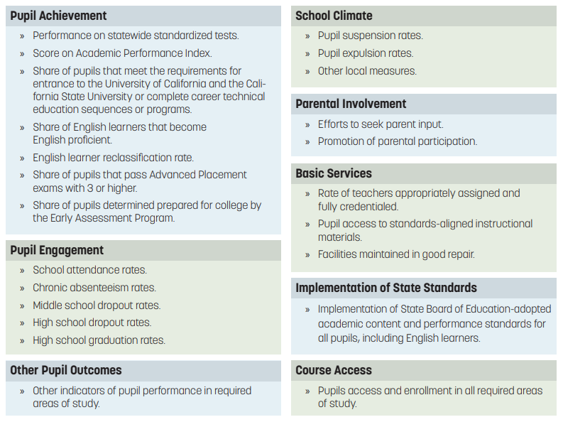
State Priorities and Required Data Elements

Slide 7
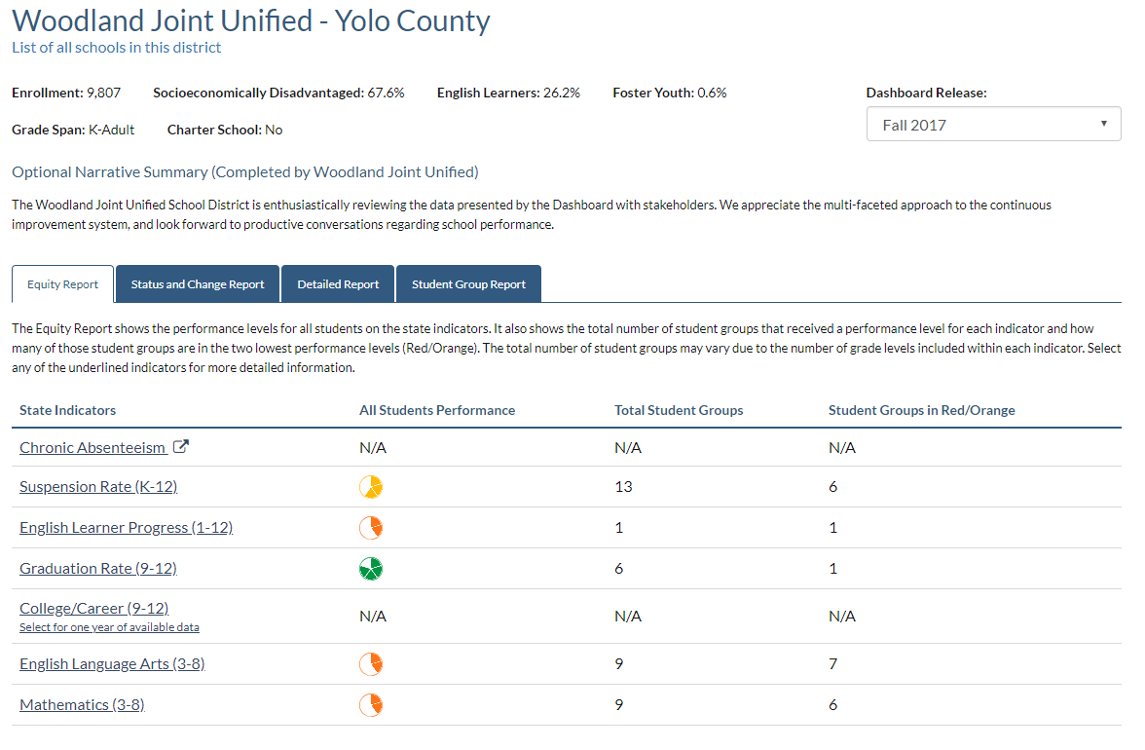
Dashboard Report – Measuring the State Priorities

Slide 8
Accountability Changes
College and Career Indicator
Dashboard Alternative School Status
Student Growth Model
Participation Rate
English Learner Progress Indicator
Chronic Absenteeism
Graduation Rate Calculation
Notes:
College/Career indicator: will include State Seal of Biliteracy, Golden State Merit Diploma, Leadership/Military Science, Articulated Pathways
DASS: modified one year graduation rate, other indicators same
Student growth model: provide information on academic progress that is easily communicated and understood
Participation rate: 95% for ELA and Math
ELPI: will not be reported on Fall 2018 Dashboard
Chronic Absenteeism: both status and change will be reported for the first time

Slide 9
Changes to Graduation Rate
Description | Old Rules | New Rules to Meet Federal Guidelines
Transfer to adult education program or to community college before the end of fourth year in high school without earning high school diploma | Removed from denominator | Remain in cohort and counted as a “dropout”
Receive an adult education diploma | Counted as traditional graduate (i.e., included in numerator and denominator) | Remain in cohort and not counted as a graduate. (Note: These students will be counted as a non-graduate completer in DataQuest reports.)

Slide 10
What we have achieved to support student learning
Greatest Progress
Alignment of Career Technical Education pathways and development of course outlines that meet the 2013 Model CTE Standards
Coherent professional learning to support the district instructional focus, which has been defined as: All learners co-construct meaning and demonstrate deep understanding through relevant, rigorous, and inquiry based learning tasks aligned to standards
Decrease in chronic absenteeism
Decreases in suspensions
Decrease in expulsions
Development of Ethnic Studies course options to support the Ethnic Studies graduation requirement; development of a statement of purpose and standards for Ethnic Studies courses
Notes:
First we want to start off with some highlights – what has gone well this year?

Slide 11
What we have achieved to support student learning
Greatest Progress
Development and consistent use of common district assessments in Reading, Math, and Social-Emotional well-being
Development of a Memorandum of Understanding for dual enrollment with Woodland Community College
Development of partnerships with community organizations and agencies, including a partnership with the City of Woodland to establish Summer at City Hall
Increases in the number of parent workshops through Parent Empowerment
Increases in the Graduation Rate for English Learner, Low Income, and Students with Disabilities
Increase in the number of students meeting a-g requirements
Increase in the number of students at the Prepared level on the College and Career Indicator
Increase in the number of State Seals of Biliteracy awarded
Notes:
First we want to start off with some highlights – what has gone well this year?

Slide 12
LCAP Questions and Comments
Goal 1 = page 59
Goal 2 = page 71
Goal 3 = page 81
Goal 4 = page 93
Goal 5 = page 100

Slide 13
LCAP Next Steps
Finalize budget
Meet with and receive feedback from Yolo County Office of Education (YCOE)
June 14: Board of Trustees review draft LCAP Year 2018-19, Public Hearing on LCAP Year 2018-19
June 28: Board of Trustees vote on LCAP Year 2018-19, recommendation for approval of LCAP Year 2018-19

Slide 14
Questions and Comments
Notes:
Goal 4 – stakeholder engagement
Survey results
Healthy kids
Meaningful participation
Parents, teachers, and students
Not always clear how to participate, what types of opportunities, and within those, how meaningful is that participation?
Also, the entire community can rally around stakeholder engagement – it speaks to all – community based organizations, district staff, city and county,

